Slide 1

School Index
TAG Team
2024 Spring
Data Science
Senior Capstone Project
Client: StudyPool

Slide 2

Project Introduction
& Objective
The objective of this project is to develop a comprehensive database encompassing colleges, universities, and online schools across the United States. The database aims to assist students in their research endeavors by providing information on various aspects of each educational institution. Notably, the system will incorporate filtering functionalities, enhancing the efficiency of student searches and facilitating access to relevant data.

Slide 3

Team Members/Roles
Niecia Say - Data Modeler & Team Manager
Cobi Miller - Data Analyzer & Client Liaison
Nathaniel Hemans - Visualizer & Project Documentation
Benardo Avancena - Client
Helen Merhout - Client

Slide 4

Team Plan
The plan for this iteration is as follows:
Understand the specific functional requirements per the client’s request
Write up a comprehensive list of functional requirements divided up by categories
Setup Jira such that work tasks can properly defined, categorized, tracked and be divided up amongst each member of the group
Collect a series of datasets of school data, clean them, and filter out non-useful columns of information and null values
Establish a plan for which statistics will be taken and which technologies will be used for analysis
Create a Mockup Website to demonstrate the user experience for going about searching for schools

Slide 5
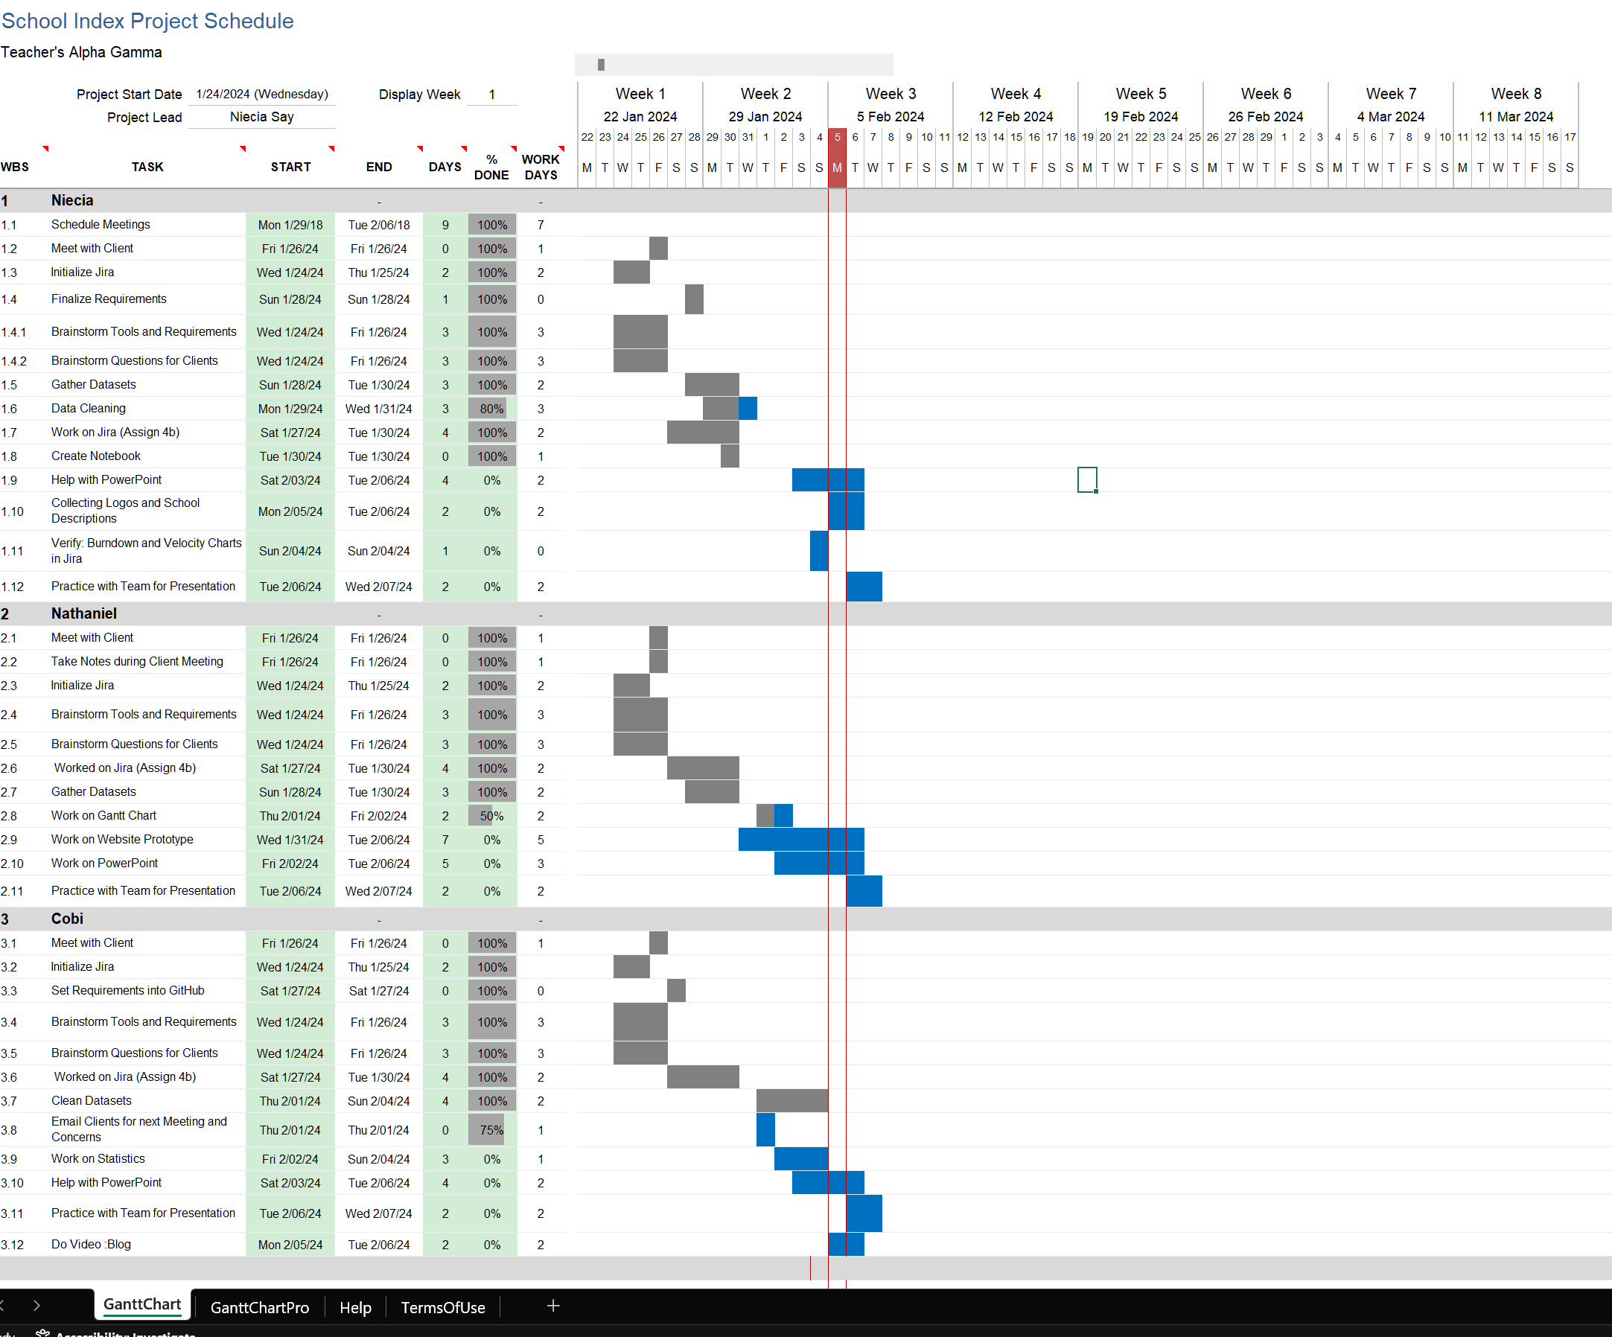
Project Charter

Slide 6
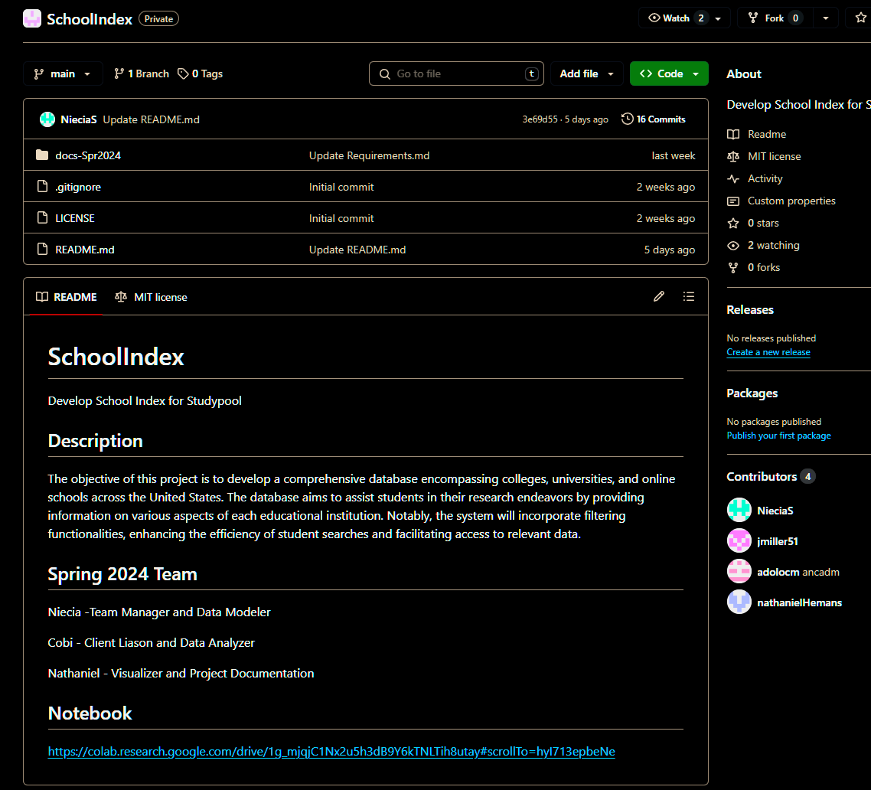
GitHub Repository

Slide 7
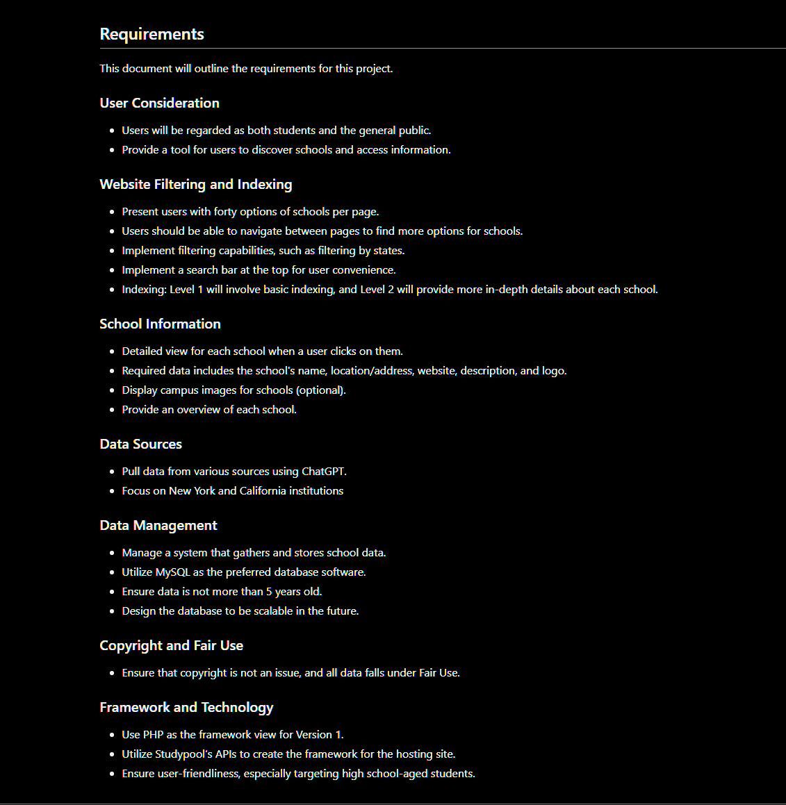
GitHub Repository

Slide 8

Dataset
The dataset provides detailed information about post-secondary educational institutions across all 50 states and U.S. territories, encompassing their location, identifiers, contact details, population, industry codes, source information, website, educational offerings, enrollment statistics, housing details, employment information, and shelter identification.
https://colab.research.google.com/drive/1g_mjqjC1Nx2u5h3dB9Y6kTNLTih8utay#scrollTo=_uC26nMALoea
Technologies : Google Colab and Excel

Slide 9
Statistical Plans
Longitude and Latitude
Geo Map
Location Statistics
Bar and Pie Charts
Enrollment Data
Data Analysis Technologies
R Studio, Python Notebook, Spark, Tableau
Numerical Statistics

Slide 10
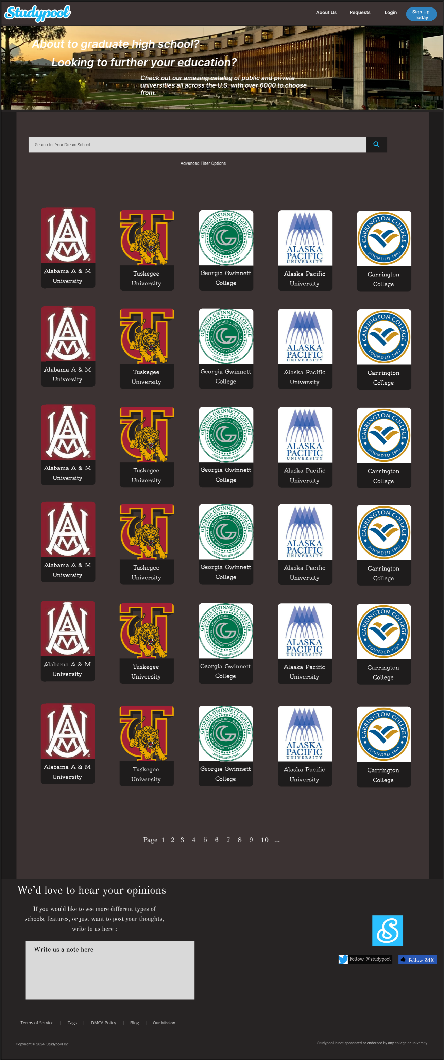
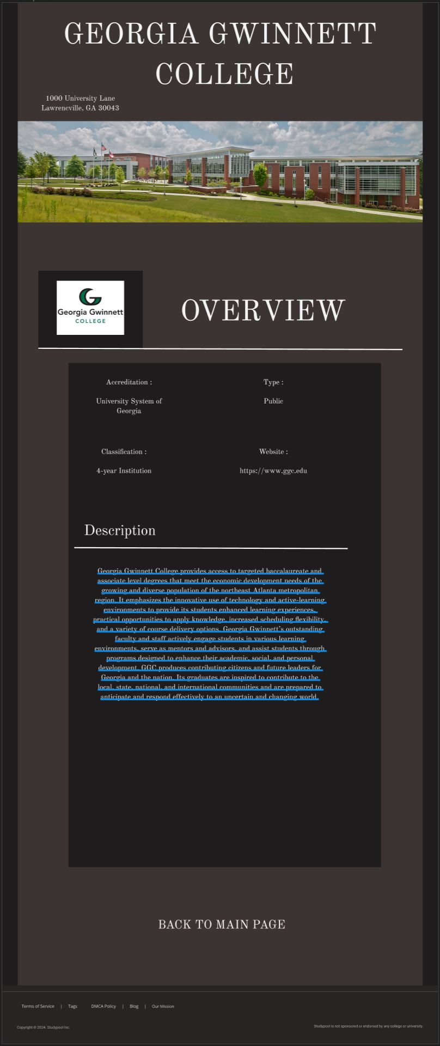
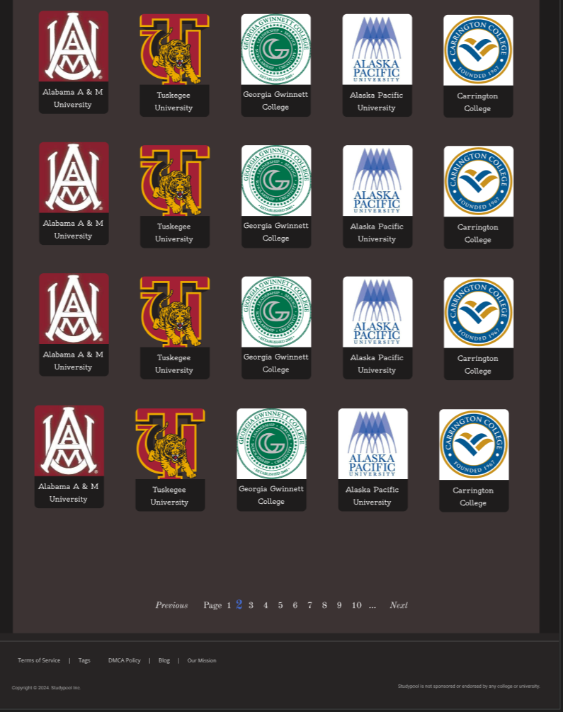
Website Mockup Design
Website Link :
Figma Website Mockup

Slide 11

Client Communication
Client meeting held January 26th
Gathered requirements
Format of the data to be collected
Further contact
Questions and clarifications
Future meeting
February 13th at 2:00 PM

Slide 12
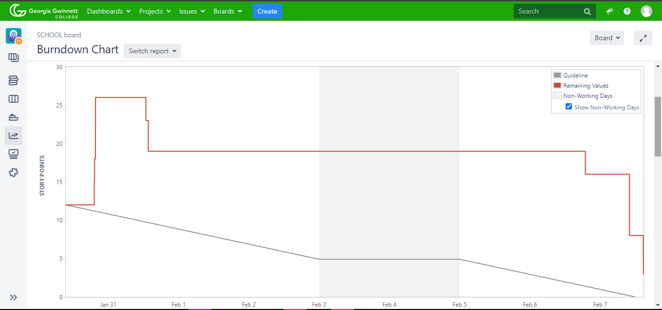
Burndown Chart

Slide 13

Links
Charter: https://onedrive.live.com/edit?id=393F7CBC5BA73909!34010&resid=393F7CBC5BA73909!34010&ithint=file%2cxlsx&authkey=!An1xB-LPWvGrOc0&wdo=2&cid=393f7cbc5ba73909
GitHub: https://github.com/GGC-DSA/SchoolIndex/tree/main
Jira: https://jira.ggc.edu/secure/RapidBoard.jspa?rapidView=203&projectKey=SCHOOL&view=planning.nodetail&issueLimit=100
Notebook: https://colab.research.google.com/drive/1g_mjqjC1Nx2u5h3dB9Y6kTNLTih8utay#scrollTo=_uC26nMALoea

Slide 14

Questions

